Slide 1


Java Training Day 5

Slide 2
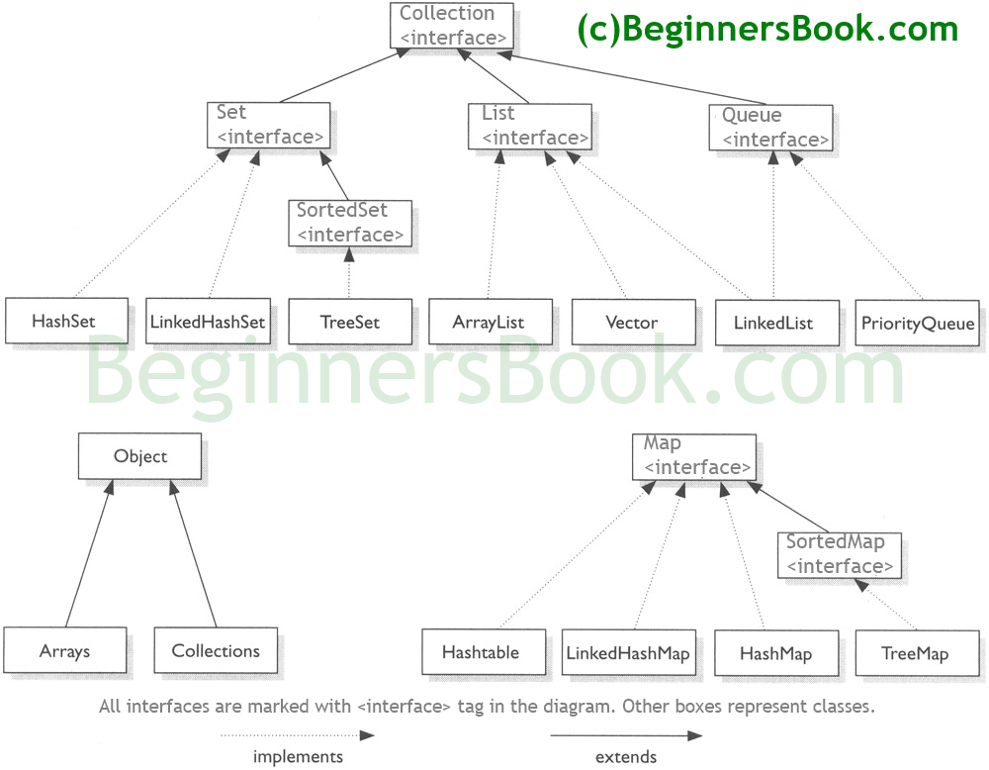
Collection Framework

Slide 3
Collection Framework
List
A List is an ordered Collection (sometimes called a sequence). Lists may contain duplicate elements. Elements can be inserted or accessed by their position in the list, using a zero-based index.
ArrayList
LinkedList
Vector

Slide 4
Collection Framework
Set
A Set is a Collection that cannot contain duplicate elements. There are three main implementations of Set interface: HashSet, TreeSet, and LinkedHashSet. HashSet, which stores its elements in a hash table, is the best-performing implementation; however it makes no guarantees concerning the order of iteration. TreeSet, which stores its elements in a red-black tree, orders its elements based on their values; it is substantially slower than HashSet. LinkedHashSet, which is implemented as a hash table with a linked list running through it, orders its elements based on the order in which they were inserted into the set (insertion-order).
HashSet
LinkedHashSet
TreeSet

Slide 5
Collection Framework
Map
A Map is an object that maps keys to values. A map cannot contain duplicate keys. There are three main implementations of Map interfaces: HashMap, TreeMap, and LinkedHashMap.
HashMap: it makes no guarantees concerning the order of iteration
TreeMap: It stores its elements in a red-black tree, orders its elements based on their values; it is substantially slower than HashMap.
LinkedHashMap: It orders its elements based on the order in which they were inserted into the set (insertion-order).
HashMap
TreeMap
LinkedHashMap

Slide 6
Collection Framework
Iterator/ListIterator
Both Iterator and ListIterator are used to iterate through elements of a collection class. Using Iterator we can traverse in one direction (forward) while using ListIterator we can traverse the collection class on both the directions(backward and forward). To know more differences between these two refer this article: Difference between Iterator and ListIterator.
Iterator
ListIterator

Slide 7
Collection Framework
Java ArrayList class uses a dynamic array for storing the elements.
It extends AbstractList class and implements List interface.
Java ArrayList class can contain duplicate elements.
Java ArrayList class maintains insertion order.
Java ArrayList class is non synchronized.
Java ArrayList allows random access because array works at the index basis.
In Java ArrayList class, manipulation is slow because a lot of shifting needs to be occurred if any element is removed from the array list.

Slide 8
Java Non-generic Vs Generic Collection
Java collection framework was non-generic before JDK 1.5. Since 1.5, it is generic.
Java new generic collection allows you to have only one type of object in collection. Now it is type safe so typecasting is not required at run time.
The old non-generic example of creating java collection.
ArrayList al=new ArrayList();//creating old non-generic arraylist
Let's see the new generic example of creating java collection.
ArrayList<String> al=new ArrayList<String>(); //creating new generic arraylist
In generic collection, we specify the type in angular braces. Now ArrayList is forced to have only specified type of objects in it. If you try to add another type of object, it gives compile time error.

Slide 9

Initialization using Arrays.asList
Syntax:
ArrayList<Type> obj = new ArrayList<Type>(
Arrays.asList(Object o1, Object o2, Object o3, ....so on));
Example:
import java.util.*;
public class InitializationExample1 {
public static void main(String args[]) {
ArrayList<String> obj = new ArrayList<String>(
Arrays.asList("Pratap", "Peter", "Harsh"));
System.out.println("Elements are:"+obj);
}
}

Slide 10
Looping ArrayList in Java
There are four ways to loop ArrayList:
For Loop
Advanced for loop
While Loop
Iterator
Example will be shared via eclipse

Slide 11
Find length of ArrayList in Java
By using size() method of ArrayList class we can easily determine the size of the ArrayList. This method returns the number of elements of ArrayList.
public int size()

Slide 12
package beginnersbook.com;
import java.util.ArrayList;
public class Details
{
public static void main(String [] args)
{
ArrayList<Integer> al=new ArrayList<Integer>();
System.out.println("Initial size: "+al.size());
al.add(1);
al.add(13);
al.add(45);
al.add(44);
al.add(99);
System.out.println("Size after few additions: "+al.size());
al.remove(1);
al.remove(2);
System.out.println("Size after remove operations: "+al.size());
System.out.println("Final ArrayList: ");
for(int num: al){
System.out.println(num);
}
}
}

Slide 13
Collection Framework
Assignment
Trim the Size of ArrayList use trimToSize() method
Replace the value of existing element in ArrayList use.set() method
Increase the capacity(size) of ArrayList use ensureCapacity() method
Check whether ArrayList is empty or not use isEmpty() method

Slide 14
The End
Link references
https://docs.oracle.com/javase/tutorial/
http://docs.oracle.com/javase/tutorial/java/
Poonam Shah
Email id : poonam.shah1985@gmail.com
Phone : 4087681459

